Slide 1
License Plate Detection
Three Musketeers
Amey Ambaji
Krishna Aryal
Aditya Aranya

Slide 2
DATASET
N = 510
University of Zagreb

Slide 3
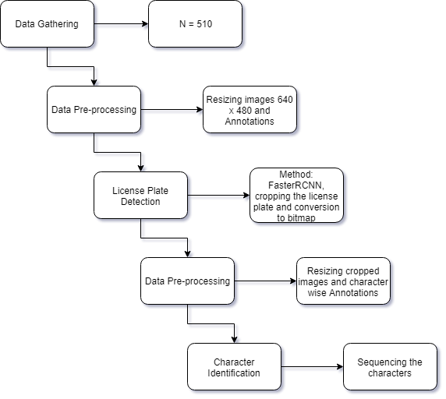
WORKFLOW

Slide 4
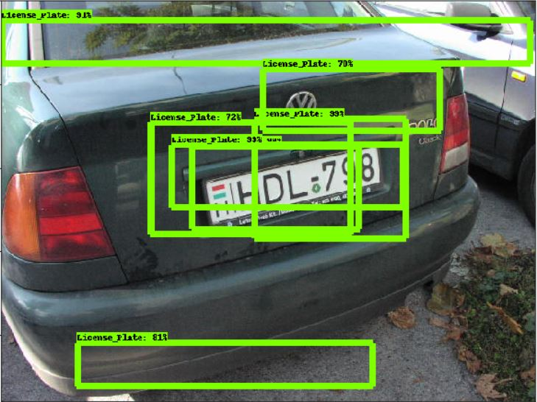
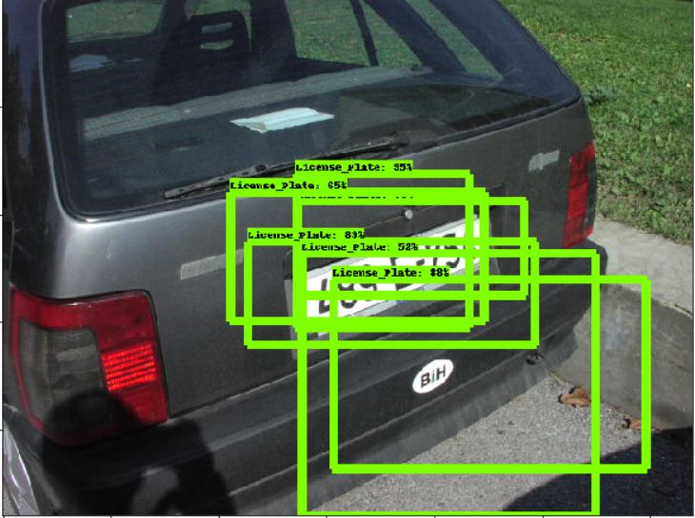
Detecting License Plate
Stage 1 Experiment 1(SSD)
Results

Slide 5
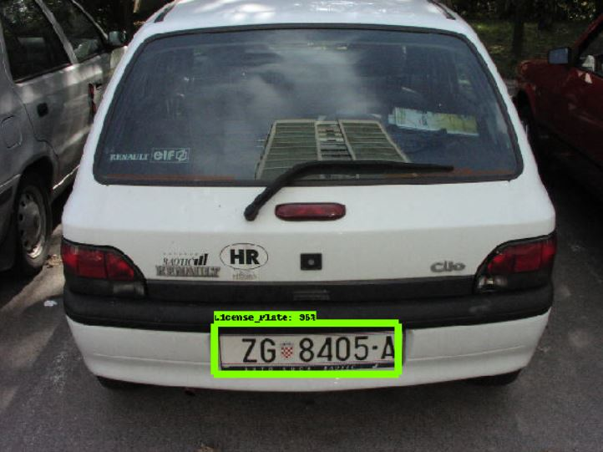
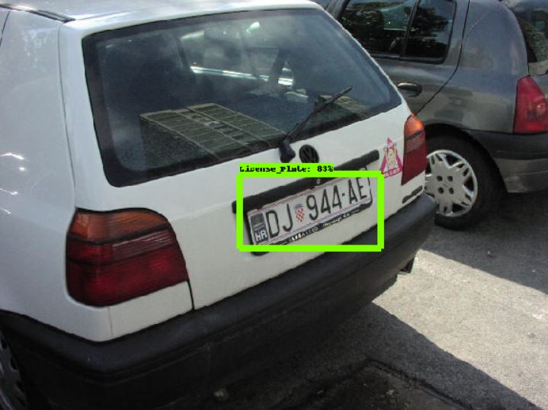
Detecting License Plate
Stage 1 Experiment 2 (Faster RCNN)
Results

Slide 6
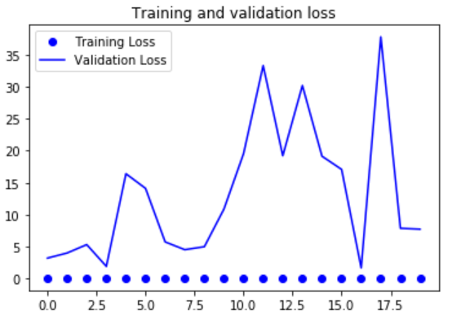
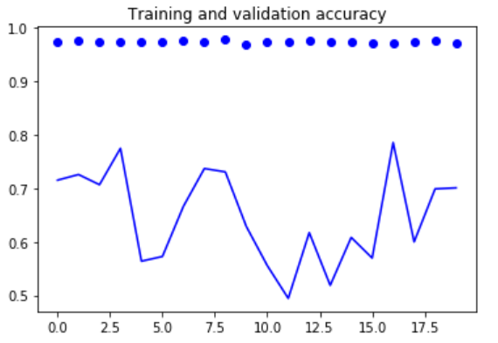
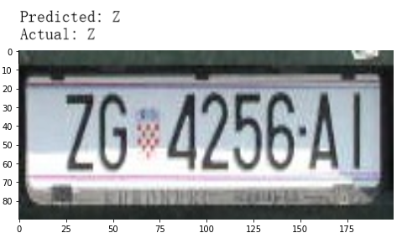
Identifying Characters
Stage 2 Experiment 1 (VGG16)
Results

Slide 7
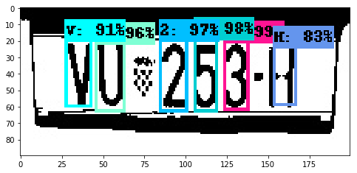
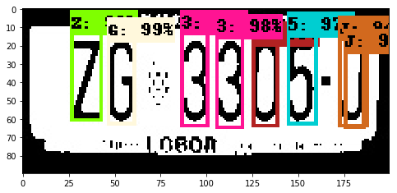
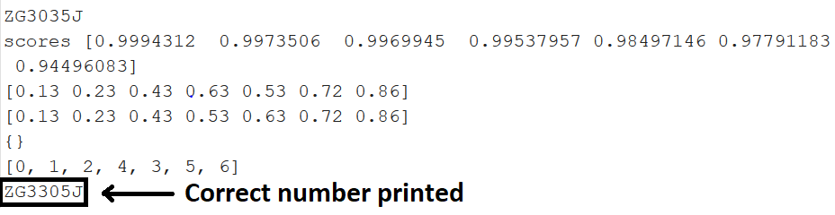


Identifying Characters
Stage 2 Experiment 2 (Faster RCNN)
Results

Slide 8

GUI DEMONSTRATION

